Slide 1







Enterprise Blockchain Developers (Intermediate)
In support of
Powered By

Slide 2
Outline
Frontend Roadmap
Backend Roadmap
DevOps Roadmap
© 2017-2020 SmartMesh Foundation Pte. Ltd. | MeshBox Foundation Pte. Ltd.

Slide 3
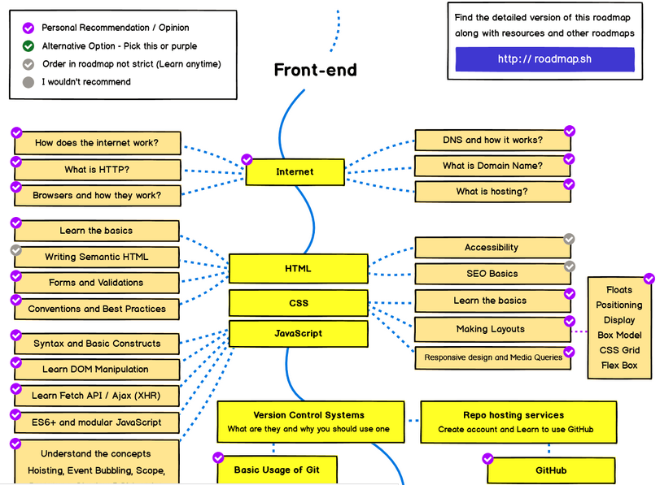
Frontend Roadmap 1

Slide 4
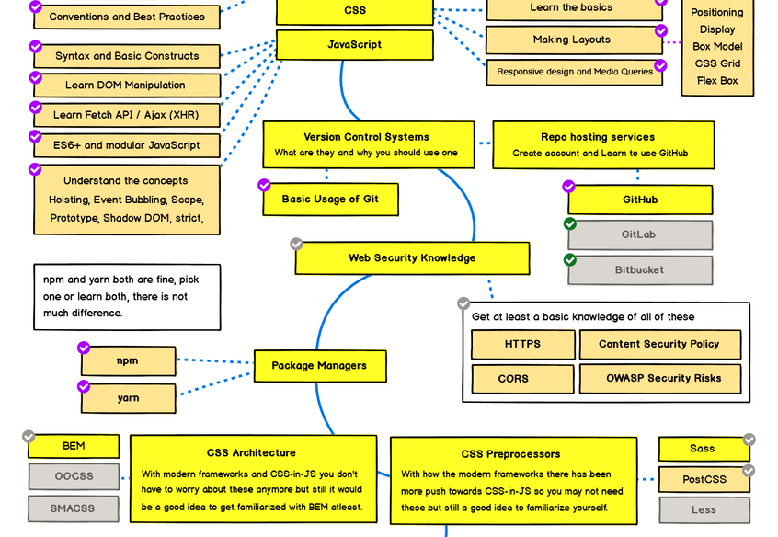
Frontend Roadmap 2

Slide 5
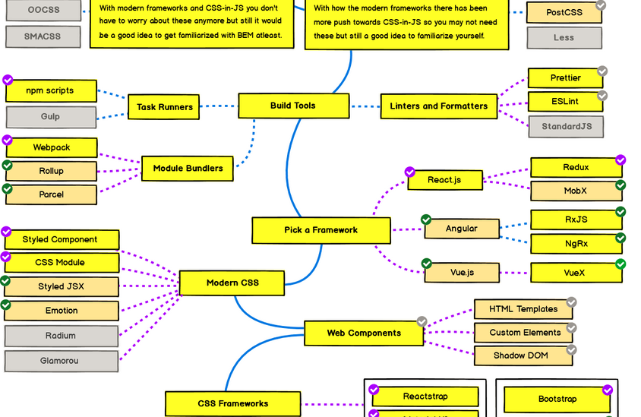
Frontend Roadmap 3

Slide 6
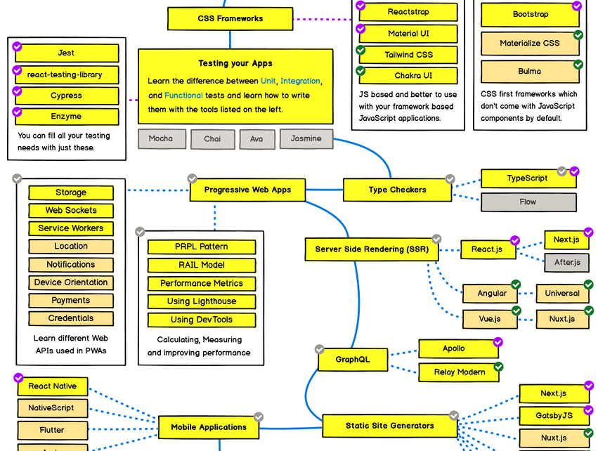
Frontend Roadmap 4

Slide 7
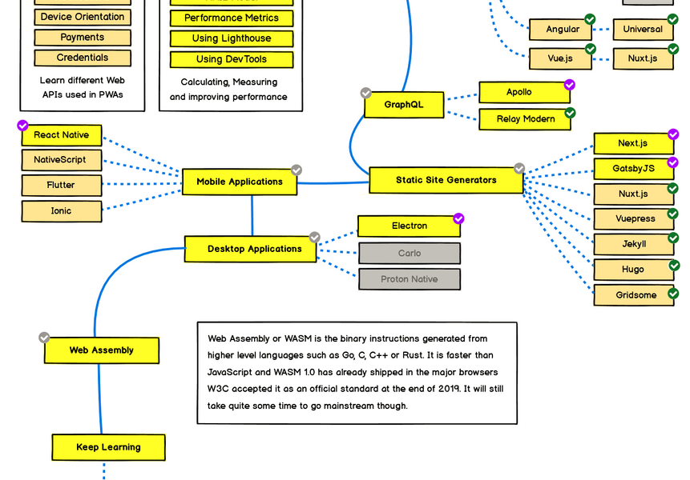
Frontend Roadmap 5

Slide 8
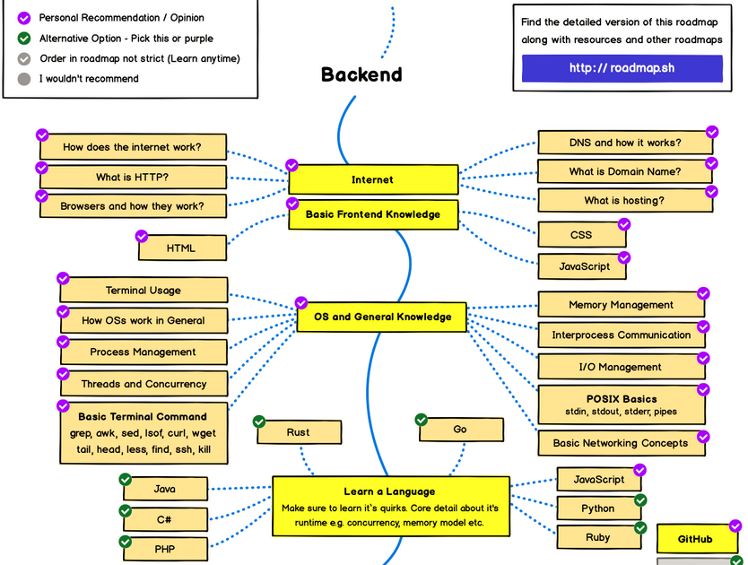
Backend Roadmap 1

Slide 9
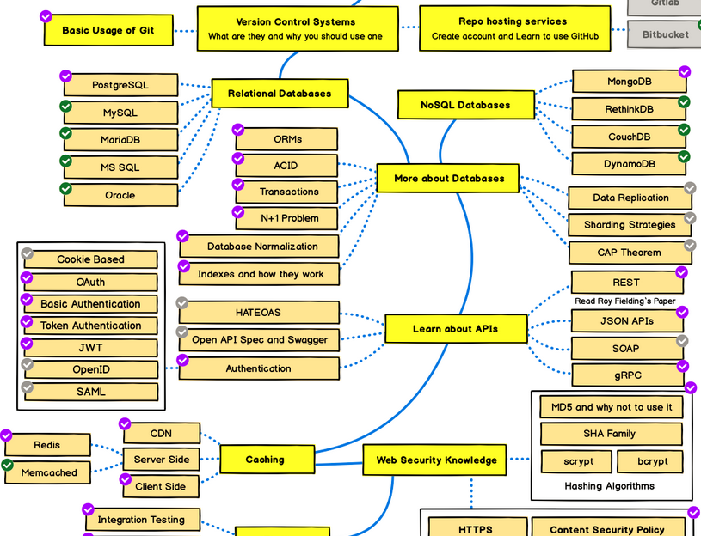
Backend Roadmap 2

Slide 10
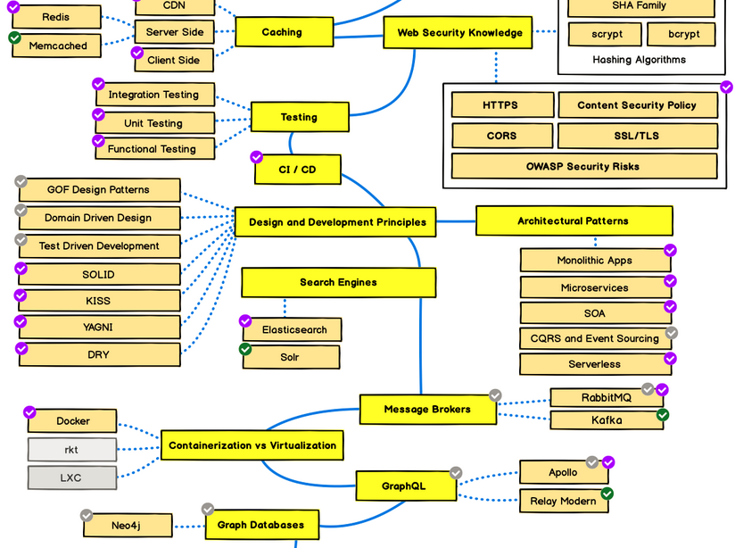
Backend Roadmap 3

Slide 11
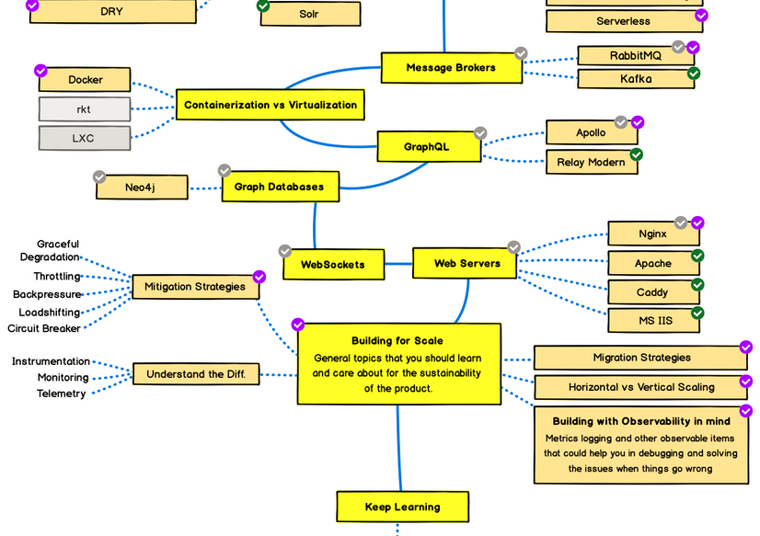
Backend Roadmap 4

Slide 12
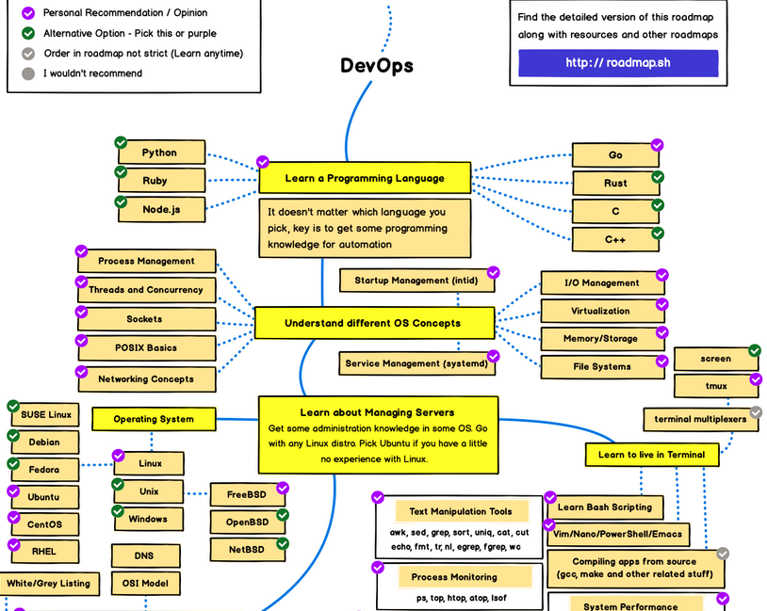
Devops Roadmap 1

Slide 13
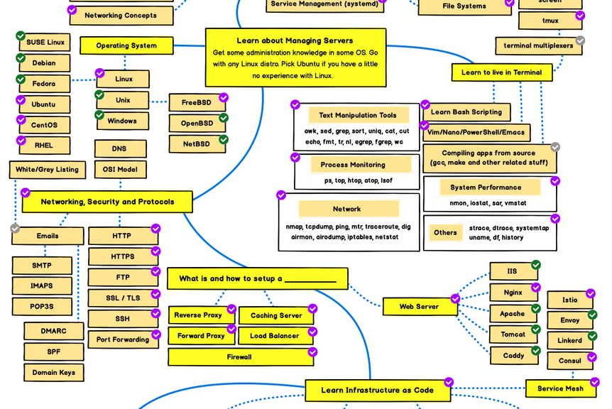
Devops Roadmap 2

Slide 14
Devops Roadmap 3

Slide 15
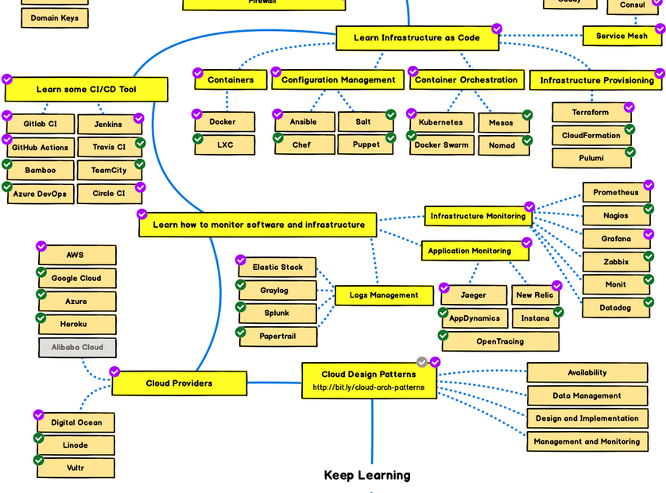
Devops Roadmap 4

